Slide 1
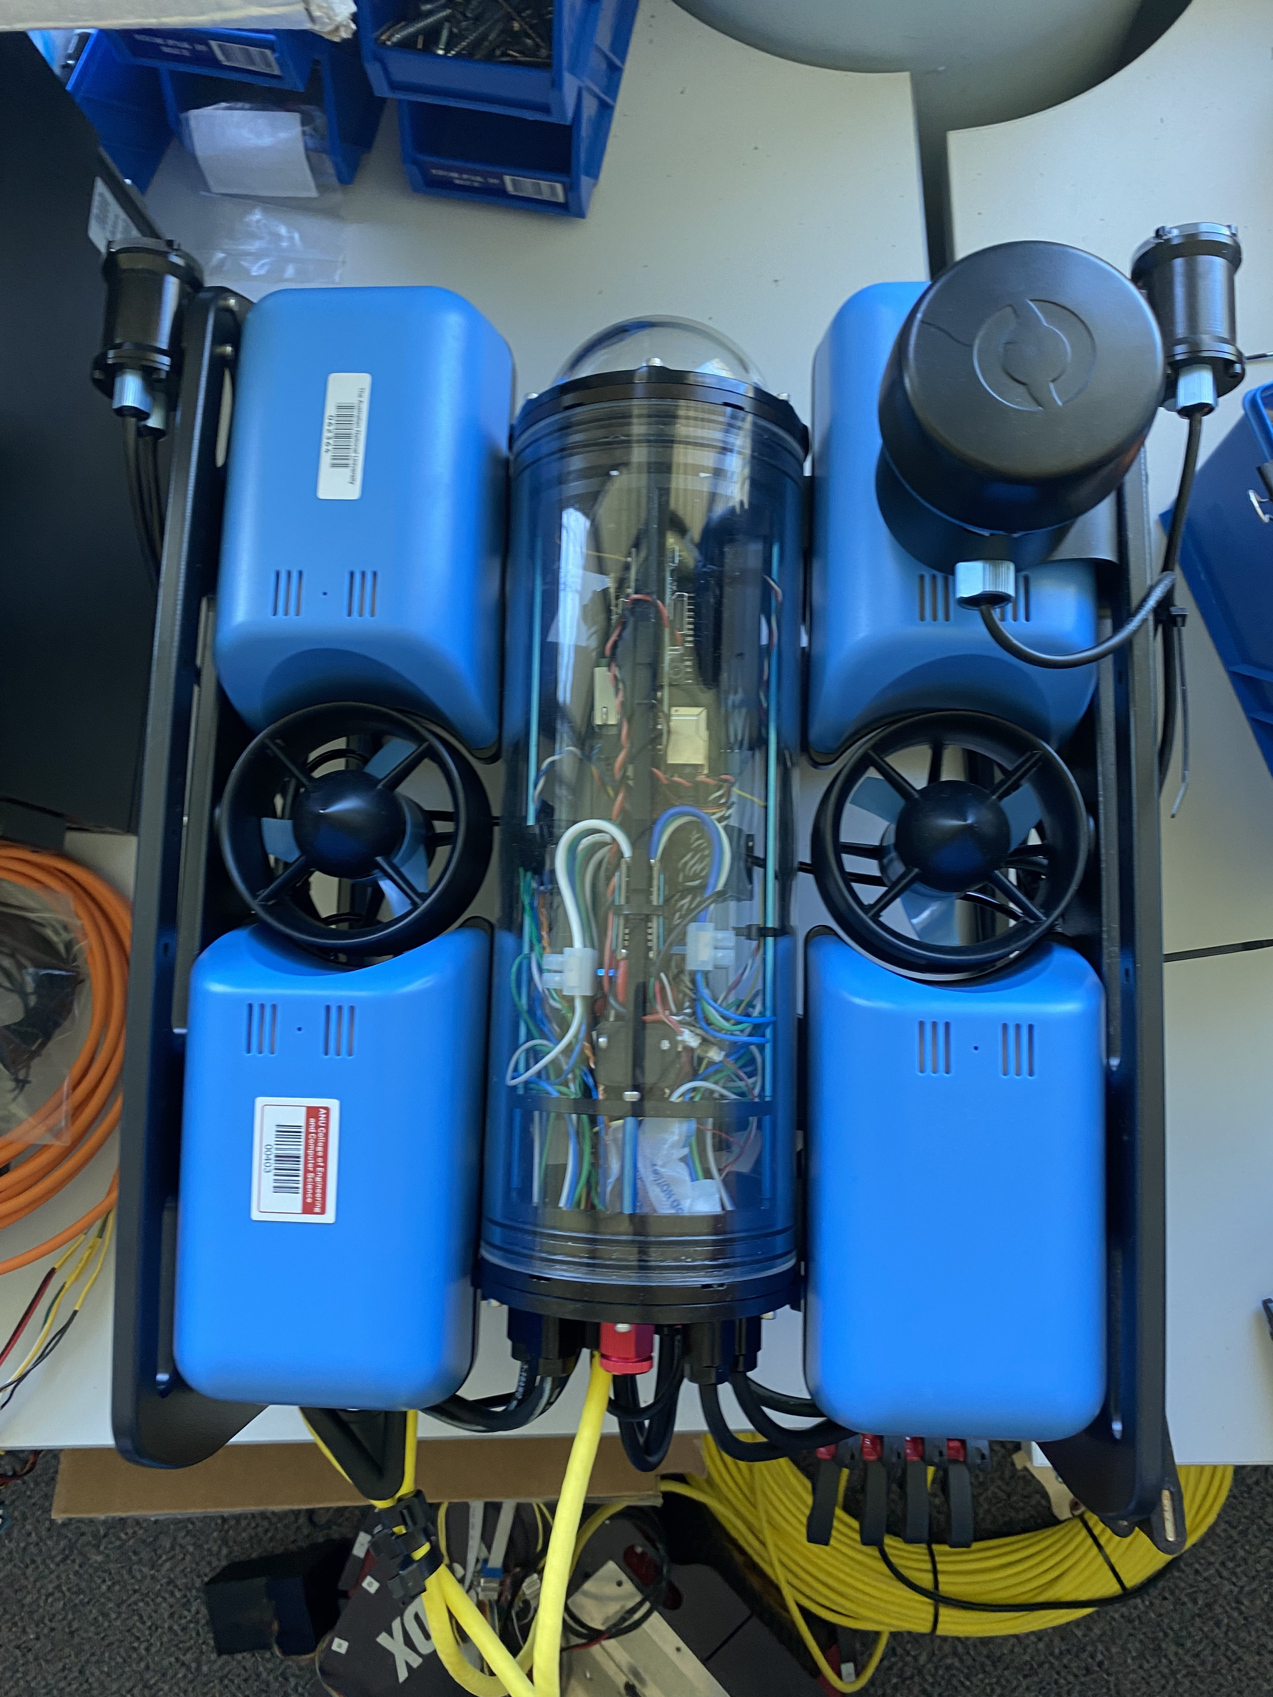
Multi-Beacon Ranging system for Underwater robotics
U5894374 Brian Ma
U7869326 Xingyu Luan
U7756428 Xiang Peng
U7559483 Yuqiao Xin
U7776558 Xu Ben
U7810272 Yuk Lam
U7757356 Yifan Wu

Slide 2
Progress Demonstration
Landing Page
Git Repository
Environment Configuration & Research of previous developer's code
Recreating distance measurement function
Requirement Analysis
Functional Analysis
Conceptual design

Slide 3
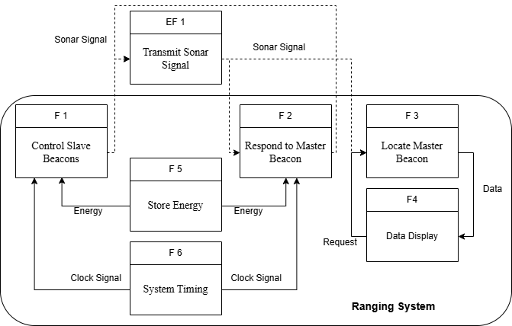
Functional Block Diagram

Slide 4
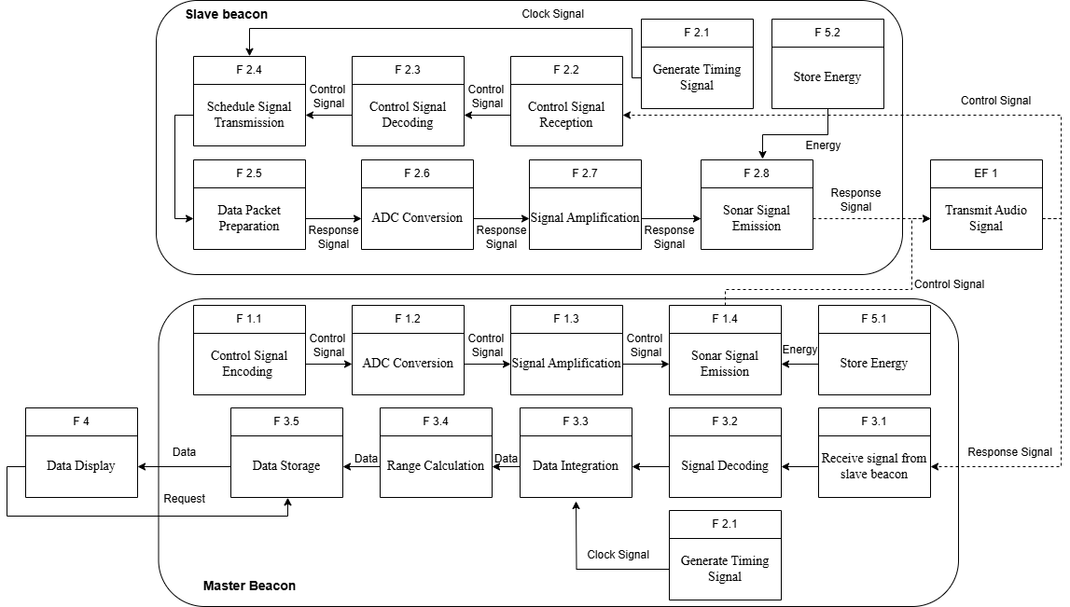

Slide 5
The Essential Casual Path
F 2.3 Decode Signal | F 2.4 Schedule Transmission | F 2.4 Encode Data Packet
Waveform superposition | Delayed responses | Amplitude envelope encoding
Fourier transform |  | Frequency encoding
Goertzel algorithm | Simultaneous transmission
Counting peaks in a time window | 1 to 1 transmission to each beacon | Peak timing encoding

Slide 6
Design Concepts Evaluation
Design Concepts | Time Consumption (R1.7 weight=0.2) | Computational Simplicity (R1.5 weight=0.3) | Signal Distinction (R1.4 weight=0.5) | Weigted Score
Counting peaks 1 to 1 transmission Peak timing encoding | 1 | 5 | 3 | 3.2
Goertzel algorithm Simultaneous transmission Frequency encoding | 5 | 0 | 4 | 3
Waveform superposition Delayed responses Amplitude envelope encoding | 2 | 3 | 3 | 2.8
0: violate requirement 1: partially meet requirement 2: just meet requirement 3. exceed requirement

Slide 7
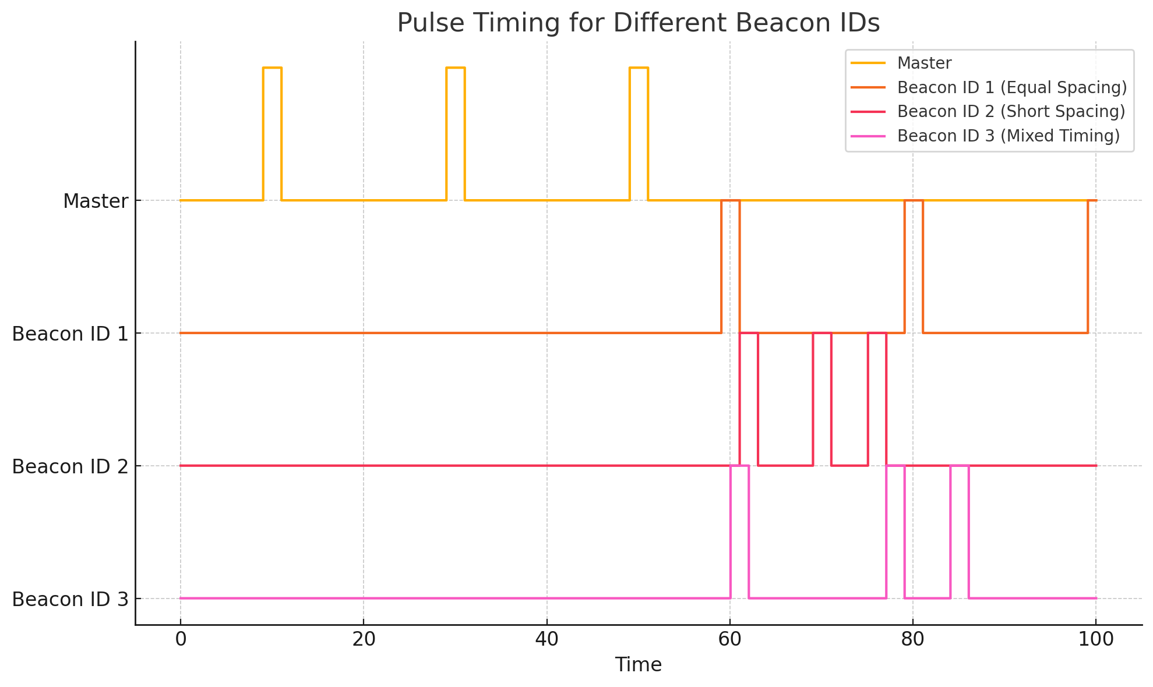
Solution – Unique ID for each beacon
Encode a unique Beacon ID in the request pulse train sent by the master.
Each beacon is preassigned an ID.
Only the beacon with matching ID will reply.
Its reply will also include its ID, so the master can identify it.
-> a Morse-code-like timing language

Slide 8
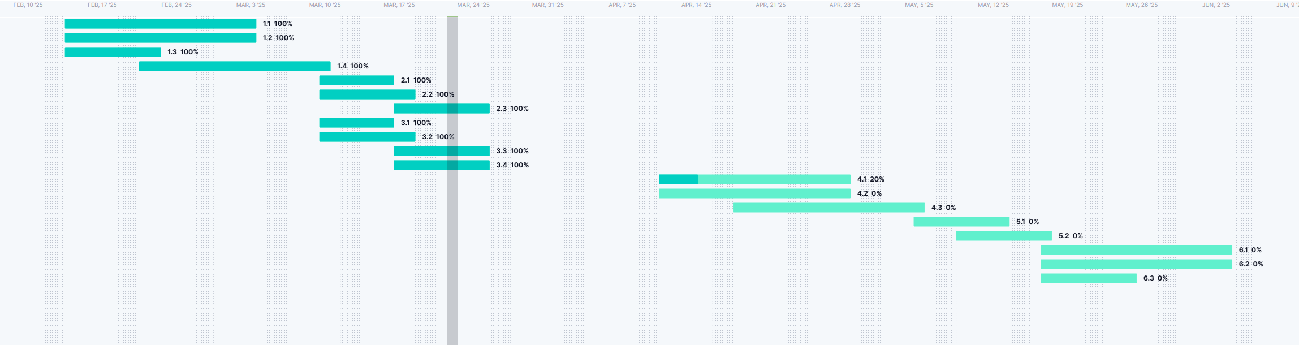
What's Next:
Prototype development
Real-World Testing & Data Collection
Design Validation
Gantt Chart for the project

Slide 9
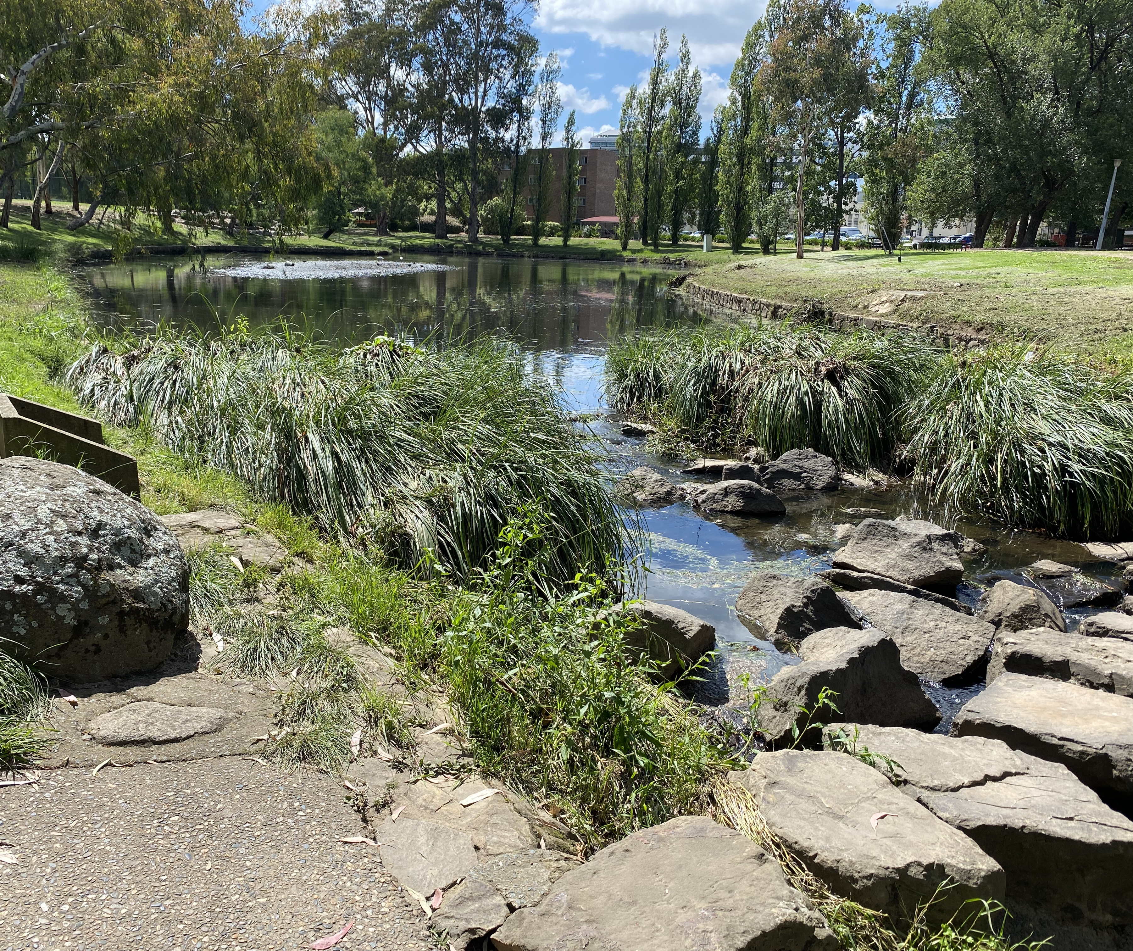
Thank you

Slide 10
Appendix

Slide 11
The Challenge – Multi-Beacon Communication
The problem
All beacons all receive a request signal from the master device
All beacons replying at once → signal collision, data confusion
What we need
A way to identify and coordinate beacon responses to avoid overlap
-> How can the master avoid signal collisions and know which beacon replied?

Slide 12
Need list
N1: locate underwater robot accurately.
N2: no cross talking between beacons.
N3: Real time tracking while robot is moving.
N4: avoid transmission error via signal encoding and processing.
N5: cause no damage to the environments.
N6: Good underwater performance and ability to be used for long periods of time.

Slide 13
Requirement list
The system shall perform real-time distance measurements one by one to at least three stationary beacons using ultrasonic signals.
The system shall combine sonar ranging data with RTK-GPS and IMU orientation data to give accurate 3D position.
The system shall achieve a ranging accuracy of ±50 cm.
The system shall provide a structured output dataset suitable for 3D underwater SLAM research.
The system shall implement Frequency Division Multiple Access (FDMA) to distinguish signals from multiple beacons.
The system shall use computational power that is suported by the stm32 chip.
The system shall support time synchronization mechanisms to ensure sensor alignment.
The system shall operate at a minimum data acquisition rate of 1Hz (at least one measurement per second).
The system shall resist background noise from water flow or other sonar systems.
The system shall record and store synchronized sensor data (sonar, IMU) for processing and analysis.
The system shall operate in freshwater environments without significant signal degradation.
The system shall perform well without error underwater.
The system shall comply with safety regulations for underwater robotics and sonar equipment and environmental protection laws.
The system shall maintain stable operation under varying environmental conditions, including minor water flow disturbances.
The system shall achieve reliable communication with beacons within a range of 100 meters.
The system shall function at depths of up to 50m meters without performance loss.
The system shall be capable of continuous operation for at least 10 hours without failure.
The system shall have redundant data logging to prevent data loss in case of power failure.
The system shall be designed for easy maintenance and allow replacement of individual sensors or processing units.

Slide 14
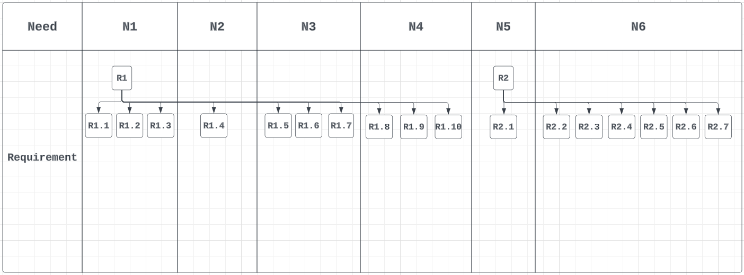
Requirement-Need Correspondence
RBS

Slide 15
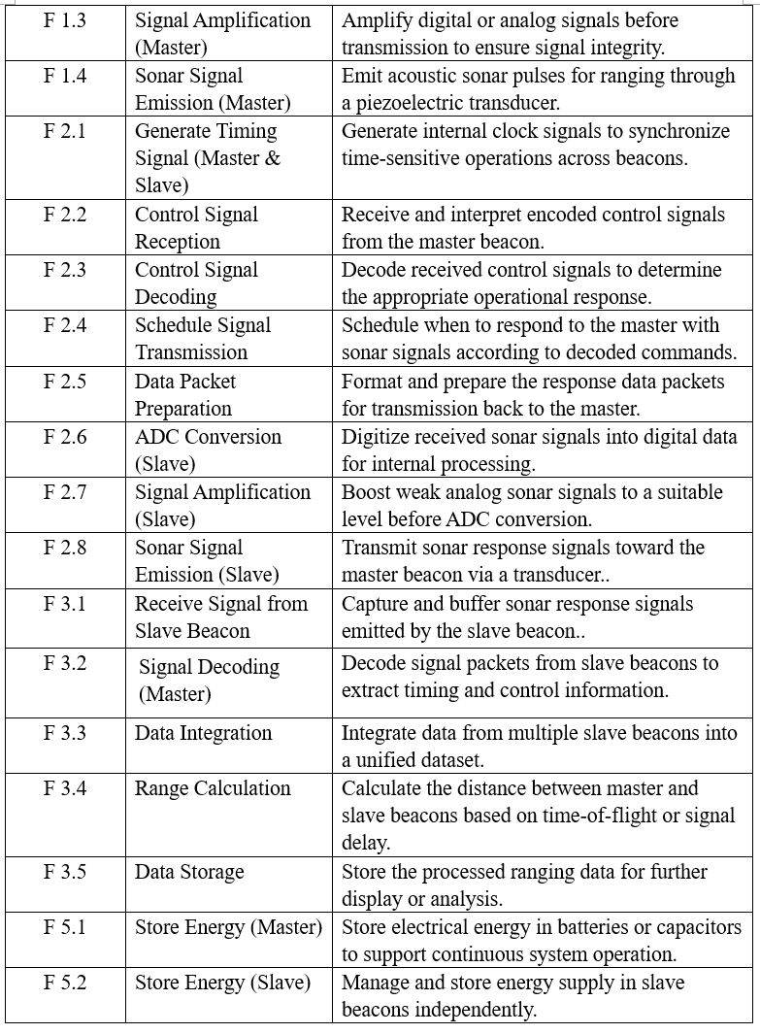
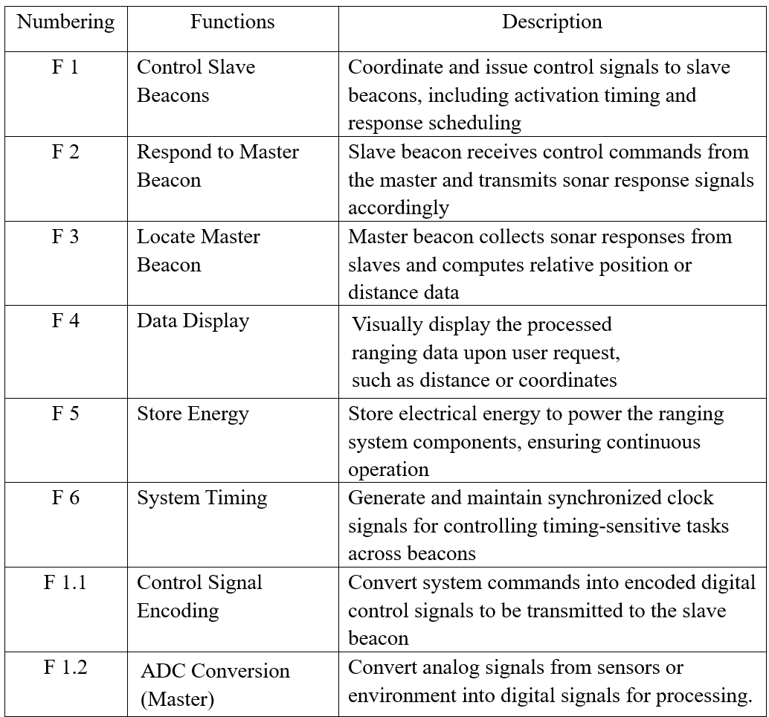
Functional Baseline

Slide 16
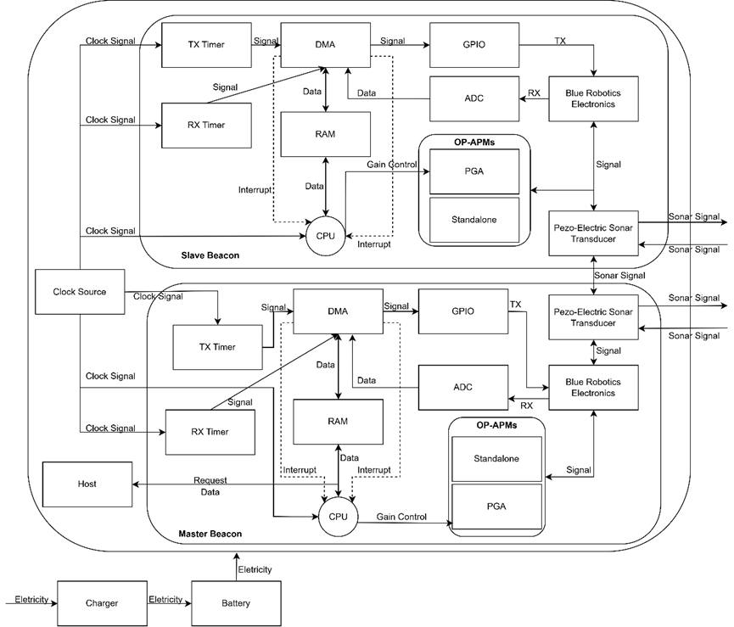
System Architecture

